Slide 1
Internship Presentation
Multiple Topics in MobiKa

Slide 2
Agenda
Introduction
Results
Recommendations

Slide 3
Introductions

Slide 4

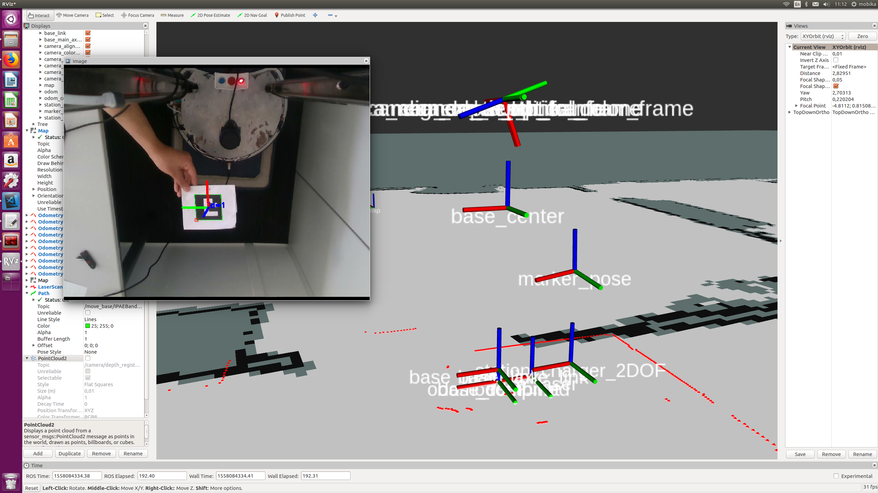
Marker Detection and Pose Estimation
Standard Aruco Marker Library http://wiki.ros.org/aruco_detect to detect the marker
Subscribe to topic /fiducial_transform
Publishing a TF between camera and the Marker and the 2D pose of the marker
Transform the 6DOF marker pose to 2DOF marker pose
How? Listen TF between 6DOF marker_pose to base_link and take only value of x, y and yaw
6DOF marker pose
2DOF marker pose

Slide 5
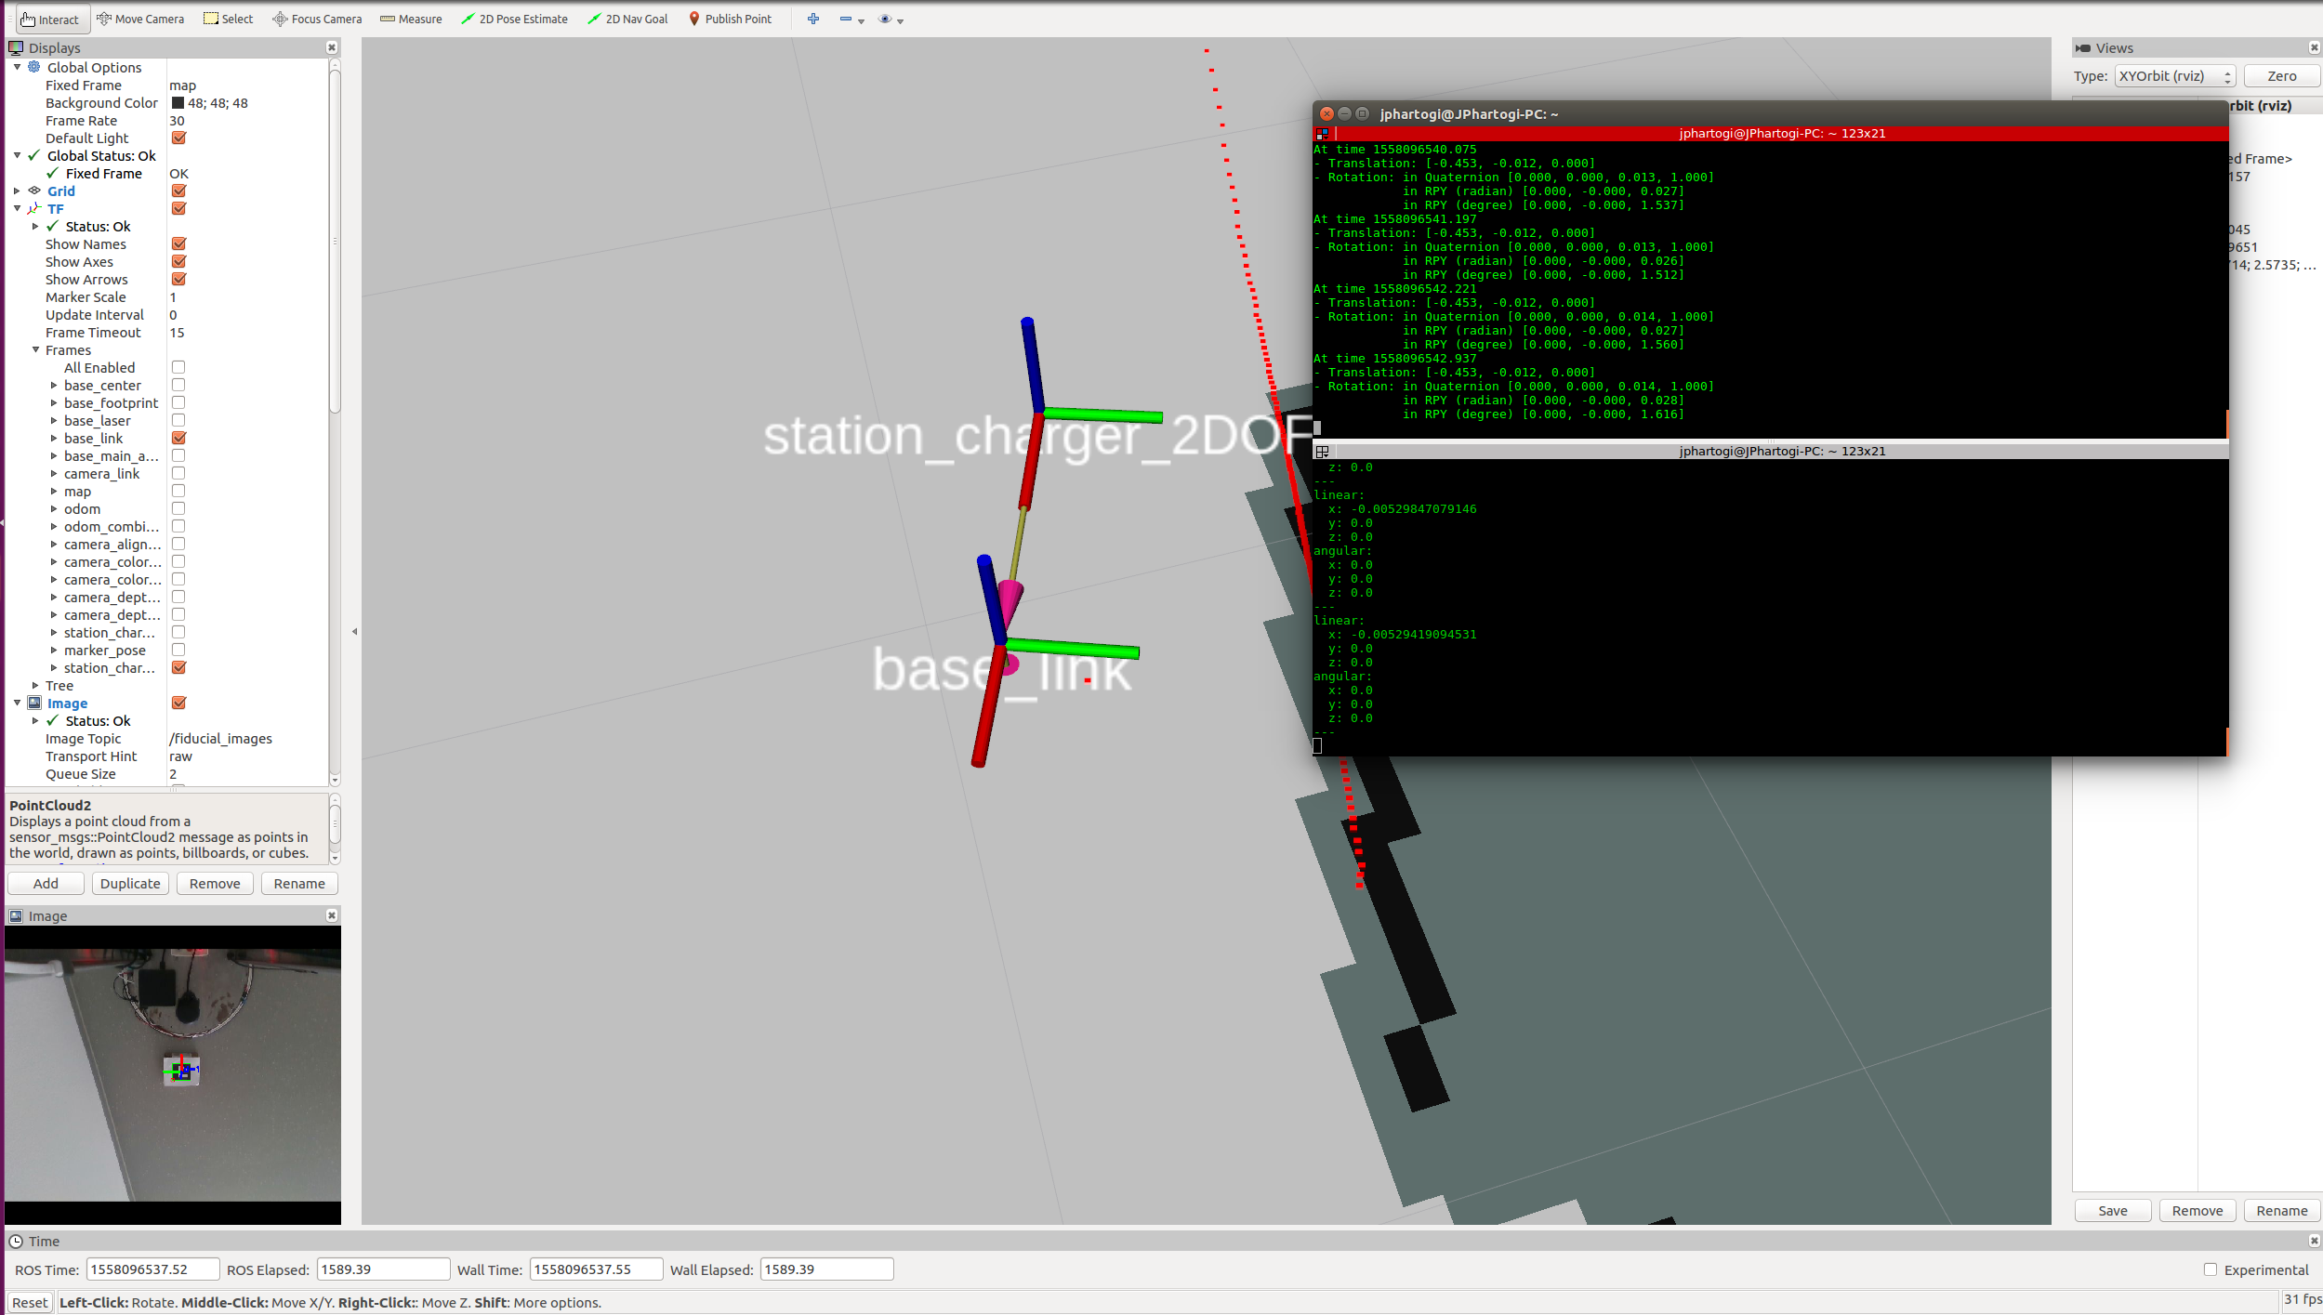
Docking Stations
Implementing and modified the IPA differential docking ( from forward docking to backward docking ) code
Test and implement docking the robot to the transformed detected marker

Slide 6
Result Video

Slide 7
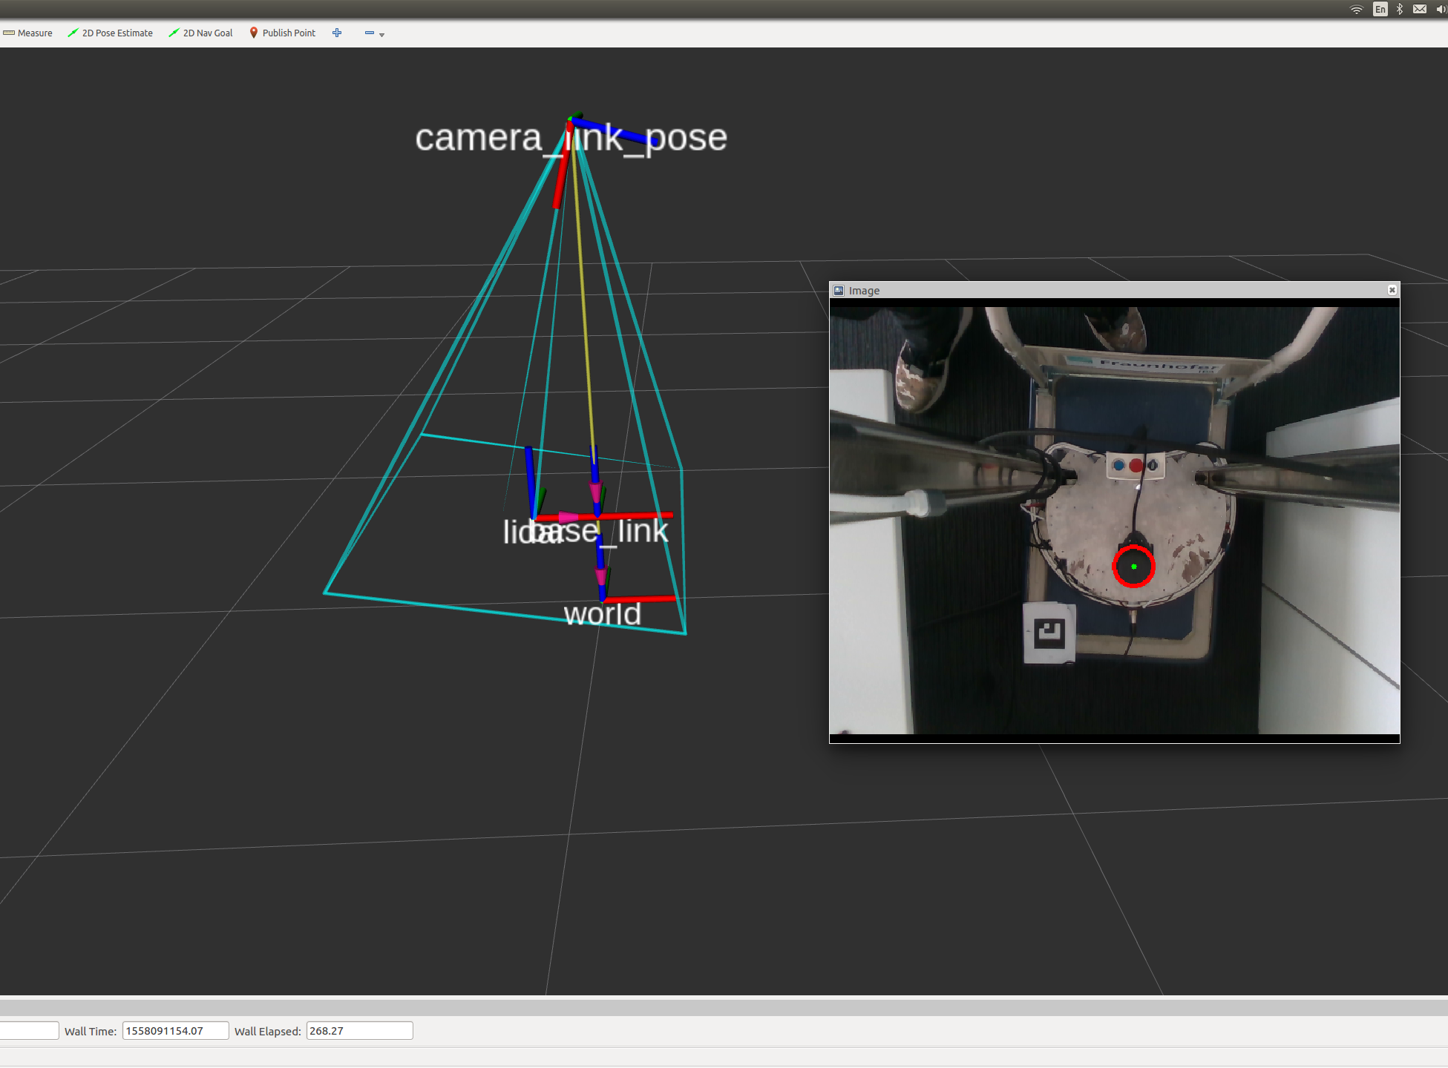
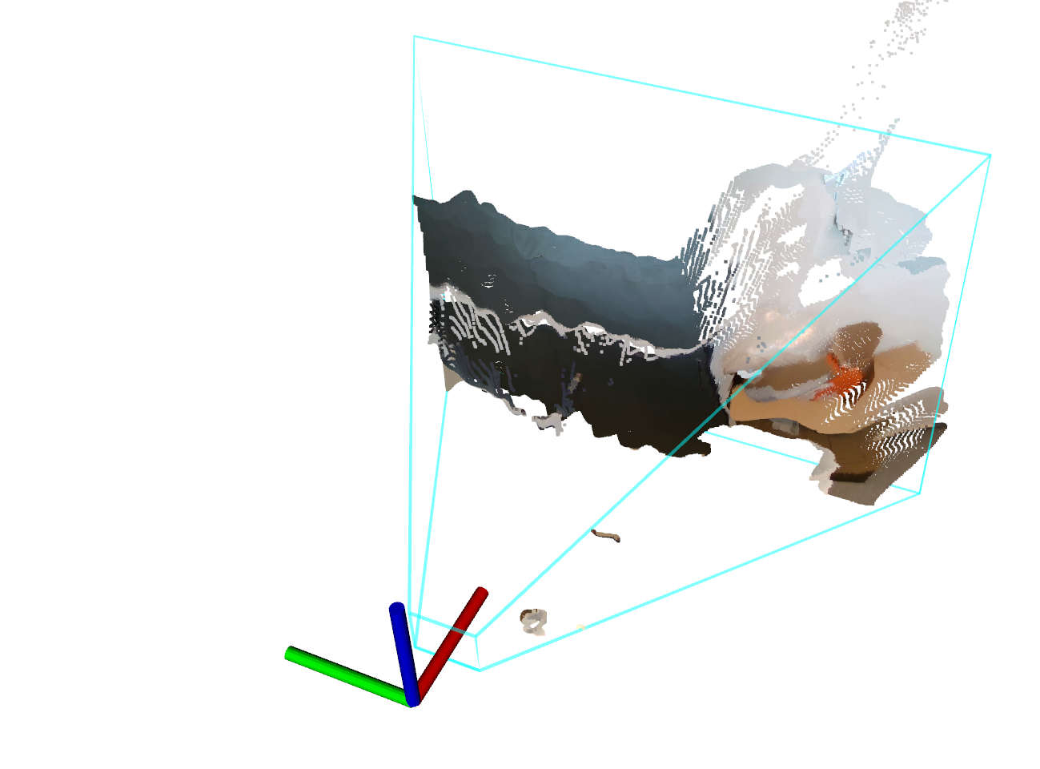
Camera pose estimation result
Using the static feature in the robot ( Lidar ) to detect the pose of the camera
Using the Hough circle transformation https://docs.opencv.org/2.4/doc/tutorials/imgproc/imgtrans/hough_circle/hough_circle.html
Publish the TF of the camera pose
Create 2 mode, debugging and not debugging mode.
Debugging mode is always calculating the pose
Not-debugging mode take 10 data and get the median of the data as final data.

Slide 8
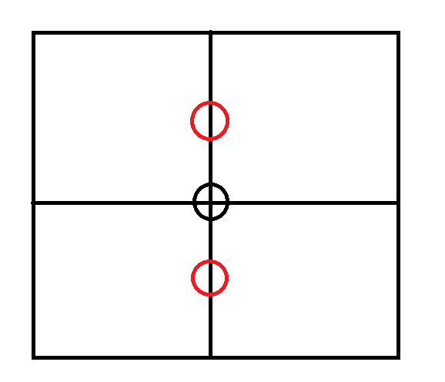
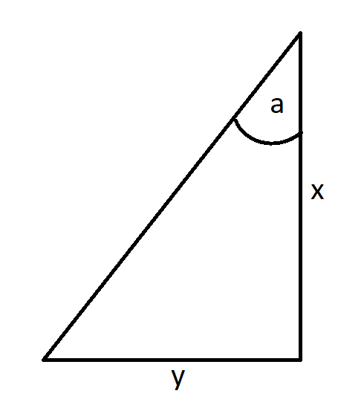

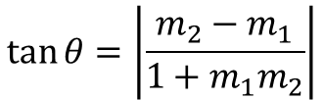


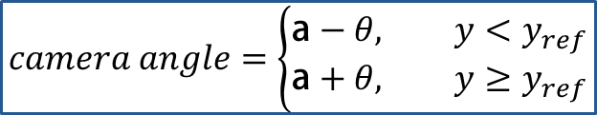
Camera Pose Initialization and Estimation
tan θ = m2−m11+m1m2
$$θ=a−b$$
$$camera angle=\left\{\begin{aligned}\text{a}−θ, y<y_{ref} \\ &\text{a}+θ, y≥y_{ref}\end{aligned}\right.$$
$$\tan{θ=\left|\frac{m_{2}−m_{1}}{{1+m}_{1}m_{2}}\right|}$$
Where $m_{2}$ = Reference gradient (const), and
$m_{1}$ = Detected circle gradient
Camera frame
Camera_link
Detected circle
a (ref angle) = $\tan^{−1}{\frac{y_{ref}}{x_{ref}}}$
reference
y
b
Lidar
x
Base_link
Notes:
Remember!
- It calculated in 2D image, because the movement of the camera is restricted in one direction only. So the detected circle will always be in one line.

Slide 9
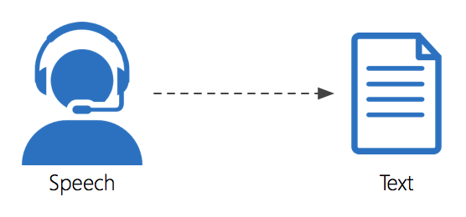
Speech Recognition
Using the online and offline (google and sphinx ) speech recognition and text to speech API
Extracting the speech into data type string, there is lot of possibility to do with the data
Example :
Extract some keywords , ( “ come “, or “ closer “ )
Decision making with yes or no question

Slide 10
Demo Speech Recognition
Robot “ Come Here “ Command
Testing speech recognition conversation

Slide 11
Tablet Height Control
Using Roboclaw motor and encoder to control the motor
Can be called with a service, the service consist of the desired height (in cm)
Controlled automatically but also can be controlled with joystick
Add acceleration and deceleration for the tablet speed

Slide 12
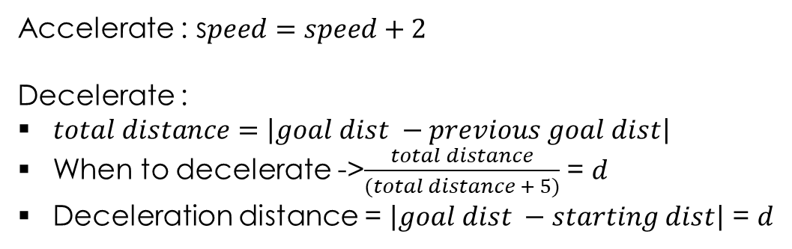


Acceleration and decceleration
Accelerate : s$peed=speed+2$
Decelerate :
$total distance=\left|goal dist −previous goal dist\right|$
When to decelerate ->$\frac{total distance}{(total distance + 5)}$ = $d$
Deceleration distance = $\left|goal dist −starting dist\right|$ = $d$
Constant speed
s$peed=\left(\frac{\max{speed −\min{speed}}}{d} ∗\left|goal_{dist}−curr_{dist}\right|\right)+\min{speed }$
accelerate
decelerate
Current speed
$v ( \frac{m}{s} )$
$$x \left( m \right)$$
Starting_dist
Goal_dist

Slide 13
Recommendations
Speech recognition is able to take people speech into string, and can be used for commands, decision and to have a simple conversation.
Docking still need to be optimized in terms of speed, precision, fixed when the marker is no longer detected by the camera to publish a last known TF in orientation to map.
Tablet height control needs to fixed especially in the initialization part, to make sure the switch is pressed firmly

